Slide 1


Slide 2

PROJECT TITLE
3/21/2024 Annual Review

Slide 3
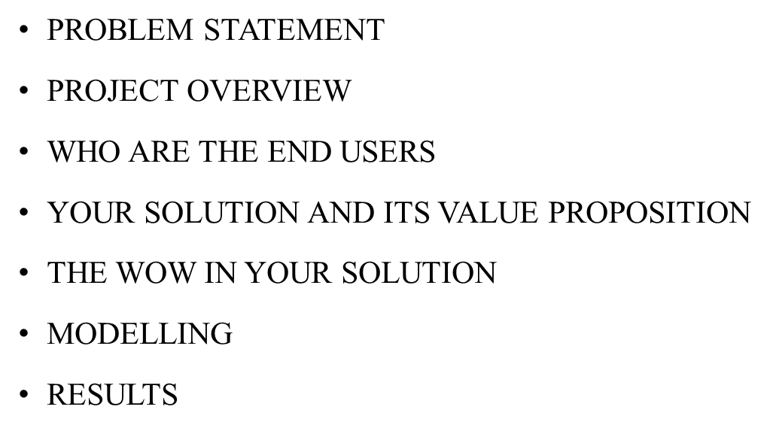


3/21/2024 Annual Review
AGENDA

Slide 4

PROBLEM STATEMENT
The aim of this project is to develop a machine learning model capable of accurately detecting and classifying various animal species based on images or audio recordings. The detection of animal species plays a crucial role in ecological monitoring, wildlife conservation, and biodiversity studies. However, manual identification of species can be time-consuming, labor-intensive, and error-prone. Hence, there is a growing need for automated systems that can efficiently identify and classify animal species.
3/21/2024 Annual Review

Slide 5

PROJECT
OVERVIEW
What we're doing:
we're building a smart system that can recognize different types of animals from pictures or sound recordings.
Why we're doing it:
it helps scientists keep track of wildlife and protect endangered species. Plus, it makes studying animals easier and faster.
3/21/2024 Annual Review

Slide 6
PROJECT
OVERVIEW
How we're doing it:
First, we gather lots of pictures and recordings of animals.
Then, we clean up and organize that data so the computer can understand it better.
Next, we teach the computer to recognize patterns in the data using special math models.
We train the computer by showing it lots of examples until it gets really good at recognizing animals.
Finally, we test the computer to make sure it's accurate and works well.
What we hope to achieve:
We want to make a user-friendly system that anyone can use to identify animals quickly and accurately, helping with wildlife research and conservation efforts.
3/21/2024 Annual Review

Slide 7

WHO ARE THE END USERS?
Wildlife researchers:
Scientists studying animal behavior, population dynamics, and biodiversity may use the system to efficiently collect data on various species in their natural habitats.
Conservationists:
Organizations and individuals involved in wildlife conservation efforts can utilize the system to monitor and protect endangered species, track habitat changes, and assess the effectiveness of conservation initiatives.
3/21/2024 Annual Review

Slide 8
WHO ARE THE END USERS?
Field biologists:
Professionals working in the field, such as field biologists and wildlife managers, may rely on the system for rapid species identification during surveys, monitoring programs, and ecological assessments.
Wildlife enthusiasts:
Amateur naturalists, wildlife photographers, and nature enthusiasts may find the system useful for identifying animals encountered in the wild or captured in photographs and recordings.
Government agencies:
wildlife management agencies and environmental regulatory bodies may deploy the system for monitoring wildlife populations, enforcing wildlife protection laws, and assessing environmental impacts of development projects.
3/21/2024 Annual Review

Slide 9

YOUR SOLUTION AND ITS VALUE PROPOSITION
It's really good at recognizing animals, which helps with things like protecting endangered species and understanding ecosystems better.
It saves time by doing the work fast, so people don't have to spend ages sorting through images.
It can handle lots of different kinds of animals and works in different environments.
It saves money because it reduces the need for people to manually identify animals.
It helps with conservation efforts by providing accurate data.
It's easy to use, so anyone can benefit from it without needing specialized training.
3/21/2024 Annual Review

Slide 10

THE WOW IN YOUR SOLUTION
Precision: our system can accurately identify animal species with astonishing accuracy, even distinguishing between closely related species, which is crucial for conservation efforts targeting specific populations.
Speed: it processes vast amounts of data rapidly, enabling near real-time analysis of wildlife populations and behaviors, which was previously impractical or impossible with manual methods.
Cost-effectiveness: by automating the detection process, our solution saves organizations significant resources that would otherwise be spent on labor-intensive manual surveys, making conservation efforts more efficient and scalable.
3/21/2024 Annual Review

Slide 11
MODELLING
Data collection: first, we gather a large dataset of images or videos containing various animals. These datasets often need to be annotated, meaning each image or video is labeled with the correct species.
Preprocessing: next, we preprocess the data to ensure uniformity and consistency. This may involve tasks such as resizing images, normalizing colors, and removing background noise.
Model selection: we then choose a suitable machine learning model architecture for our task. Common choices for image classification tasks include convolutional neural networks (cnns), which are designed to effectively analyze visual data.
n
3/21/2024 A nual Review

Slide 12
MODELLING
Training: the selected model is trained using the annotated dataset. During training, the model learns to recognize patterns and features that distinguish different animal species from each other.
Validation: after training, the model is validated using a separate dataset to assess its performance and ensure it generalizes well to unseen data.
Fine-tuning: if necessary, we may fine-tune the model by adjusting its parameters or architecture to improve its performance further.
Deployment: once the model achieves satisfactory performance, it can be deployed to analyze new images or videos for species detection in real-world applications.
n
3/21/2024 A nual Review

Slide 13
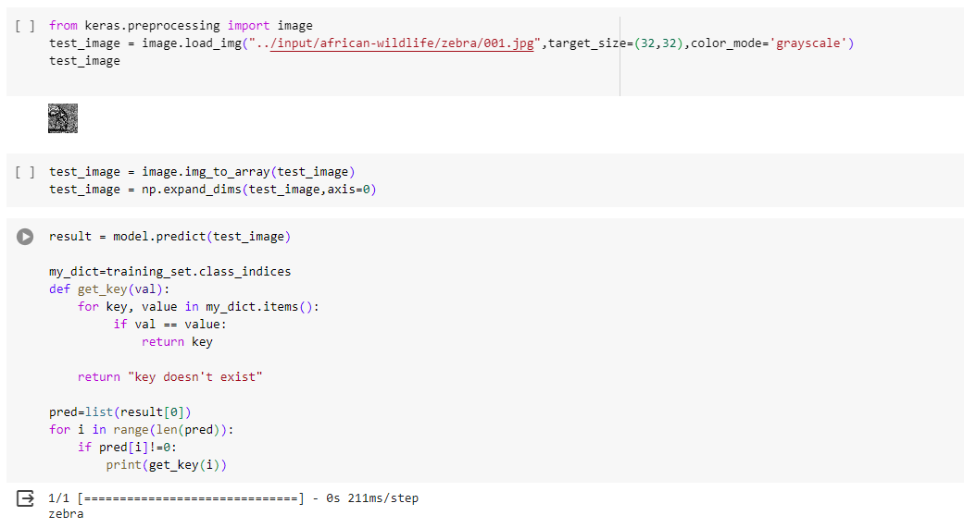
RESULTS
Demo Link
n
3/21/2024 A nual Review

